Slide 1
ResolveIT Smart Civic Grievance and Feedback Management System
Name: Gayathri B
Year : Pre – Final Year Computer Science Engineering
College: Mepco Schlenk Engineering College , Virudhunagar , Tamil Nadu
Technical Skills: Data Structures and Algorithms, SQL

Slide 2
Problem Statement
Citizens face daily civic issues such as potholes, garbage, water shortages, drainage problems, and streetlight failures.
Existing grievance systems are complex, lack transparency, and do not provide real-time updates, making complaint registration and tracking difficult.
To overcome this, ResolveIt – Smart Civic Grievance and Feedback Management System is proposed as a centralized and user-friendly platform that enables easy complaint submission, real-time tracking, and efficient grievance management, ensuring faster resolution, better accountability, and improved urban governance.

Slide 3
Objectives of the project
Easy online complaint registration
Real-time tracking of complaint status
Improve transparency & accountability
Faster complaint resolution
Scope of the Project
Web-based grievance management system
Supports Citizen, Officer, Admin modules
Covers major civic issues (garbage, water, roads, lights)
Secure login & centralized database

Slide 4
Existing System vs Proposed System
Feature | Existing System | Proposed System (ResolveIt)
Complaint Registration | Manual / Basic online | Easy online submission
Status Tracking | Not available / Delayed | Real-time tracking
Transparency | Low | High
Notifications | Not available | Instant alerts
Complaint Management | Manual handling | Automated & centralized
Feedback System | Not available | Available
Resolution Speed | Slow | Faster

Slide 5
Module features
User Module (Citizen)
Registration & Login: Citizens can create accounts and securely log in.
Complaint Submission: Easily submit grievances with details, category (pothole, water, drainage, etc.), and optional images.
Track Complaint Status: View real-time updates on their complaints (Pending, In Progress, Resolved).
Feedback & Rating: Provide feedback or rate the service after complaint resolution.
Notifications: Receive SMS/email or in-app alerts for status changes.

Slide 6
Officer Module (Government Staff / Department Officer)
Login & Dashboard: Access assigned complaints and overview of pending issues.
Complaint Assignment: Receive complaints assigned by admin or department head.
Update Status: Change complaint status (In Progress, Resolved) and add remarks or proof of resolution.
Prioritization: Handle urgent complaints first based on category/severity.
Reports: View statistics and reports of complaints handled over time.
Feedback & Rating Module
Citizens can provide feedback on resolved complaints.
Helps administration measure service quality and improve urban governance.

Slide 7
Admin Module
User Management: Manage citizens, officers, and department accounts.
Department Management: Create, modify, or remove departments handling complaints.
Complaint Oversight: Monitor all complaints city-wide, reassign if needed, ensure timely resolution.
Analytics & Reports: Generate reports on complaint trends, department performance, and citizen satisfaction.
Notifications Management: Configure alerts and notifications for citizens and officers.
Notification Module
Sends real-time updates to citizens and officers via email, SMS, or in-app notifications.
Notifies about new complaints, status changes, or resolution confirmations.

Slide 8
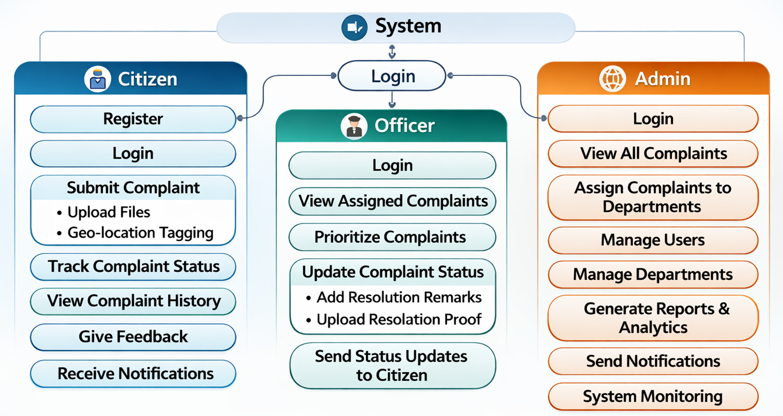
Use case Diagram

Slide 9
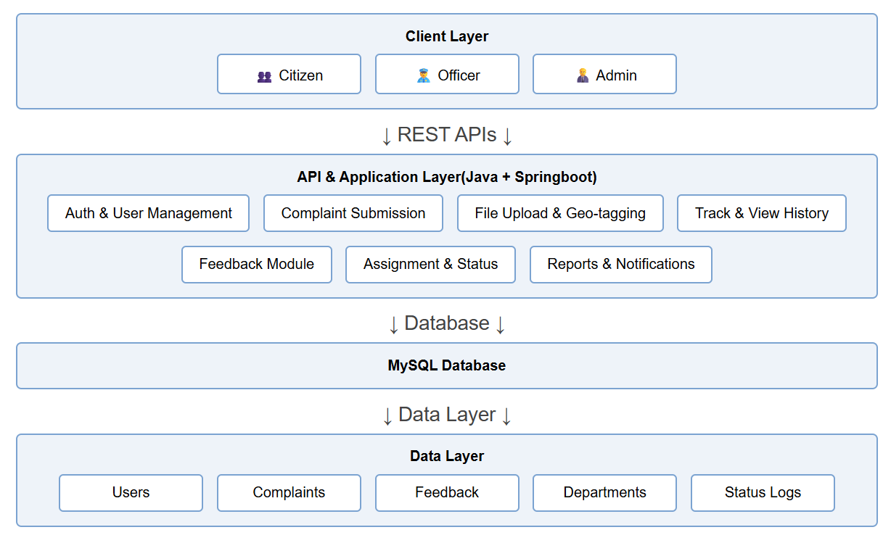
System Architecture

Slide 10
Technology Stack
Front-End: React.js, HTML, CSS, JavaScript – for the user interface.
Back-End: Java with Spring Boot – for server and application logic.
Database: MySQL – to store users, complaints, and other data.
Communication: Email/SMS – to send updates and notifications.
Security: Spring Security / JWT – to protect user data and login.

Slide 11
Easy Complaint Registration: Citizens can easily submit complaints online.
Real-Time Tracking: Users can track complaint status anytime.
Improves Transparency: Citizens can clearly see the progress of their complaints.
Faster Resolution: Helps authorities resolve issues quickly.
Centralized System: All complaints are managed in one platform.
Better Accountability: Officers are responsible for timely resolution.
User-Friendly Interface: Simple design using React makes it easy to use.
Improved Urban Governance: Helps in better planning and service improvement.
Pros

Slide 12
Challenges of the Project
Secure Authentication & Data Protection: Ensuring safe login and protection of sensitive user data.
React & Spring Boot Integration: Smooth communication between front-end and back-end systems.
Real-Time Notification Handling: Sending instant alerts without delay.
Database Design & Scalability: Handling large data efficiently as users increase.
System Maintenance & Updates: Regular monitoring, bug fixing, and performance optimization.

Slide 13
Future Enhancements
Mobile App Support (Android & iOS)
AI-based complaint classification & prioritization
Chatbot for 24/7 user support
GPS & map-based complaint tracking
Multi-language support

Slide 14
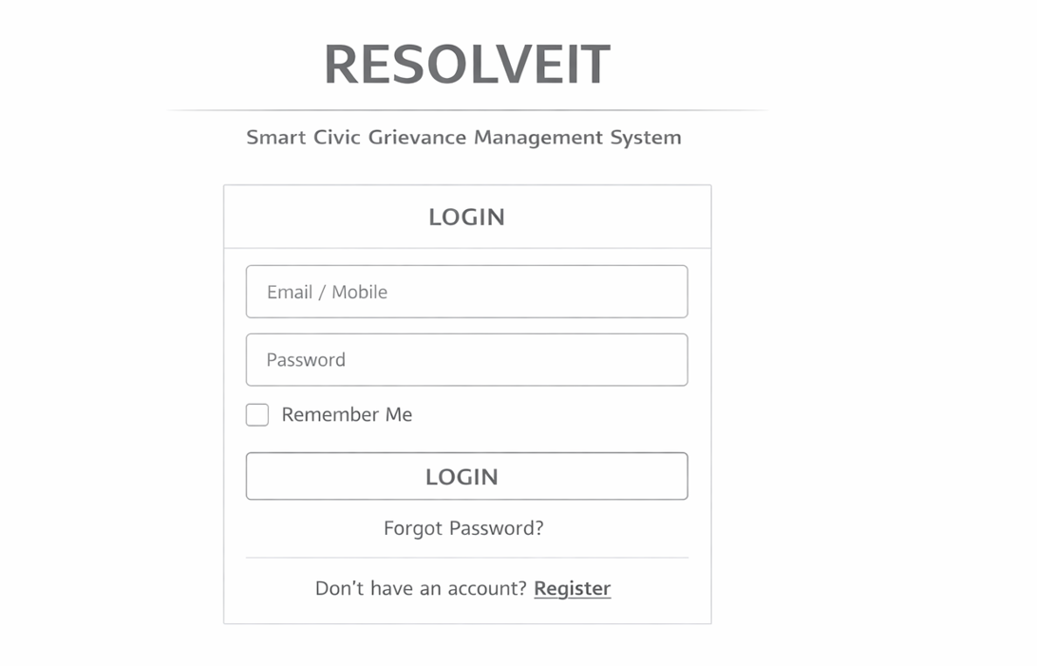
Wireframes
Login Page

Slide 15
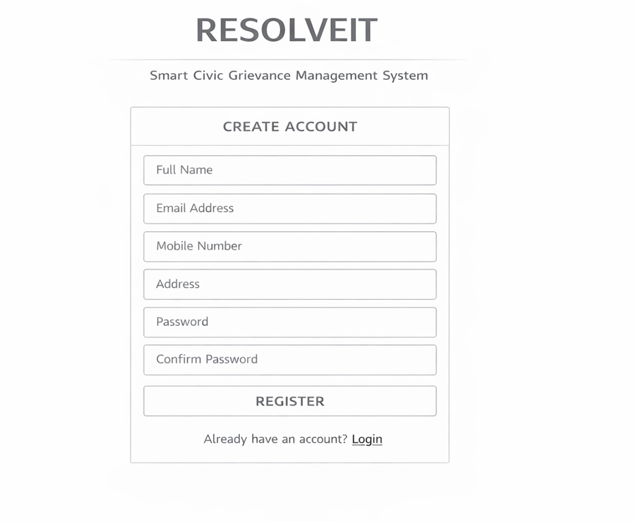
Register page

Slide 16
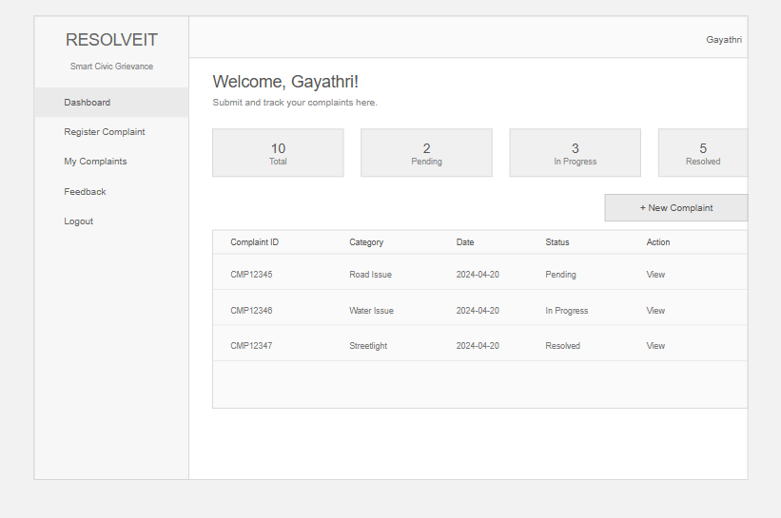
Citizen Dashboard

Slide 17
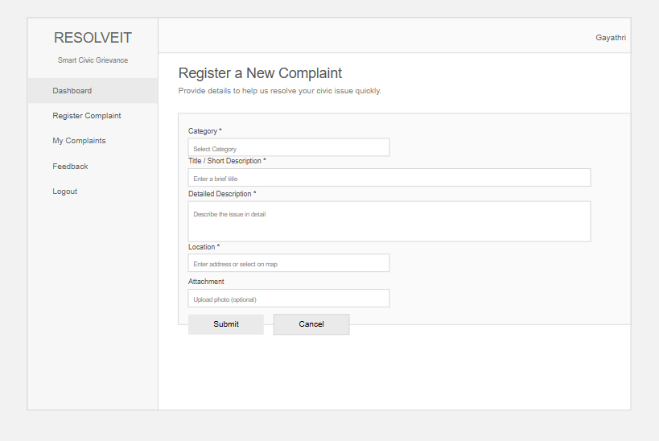
Register Complaint

Slide 18
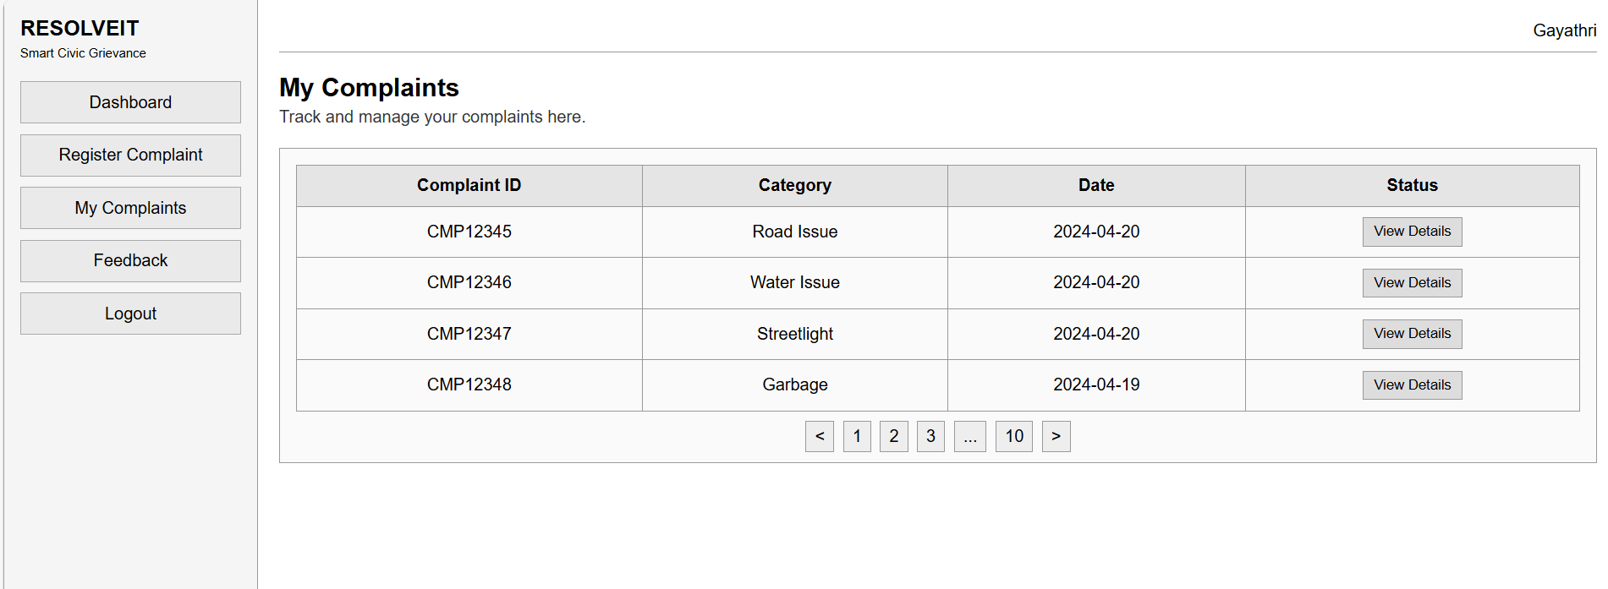
My complaints page

Slide 19
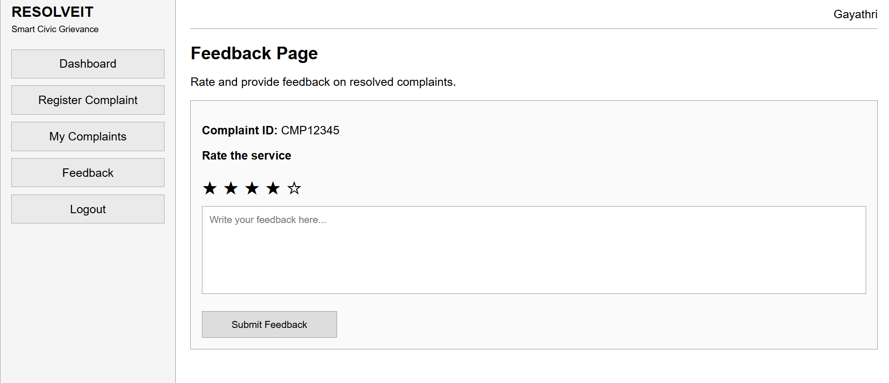
Feedback Page

Slide 20
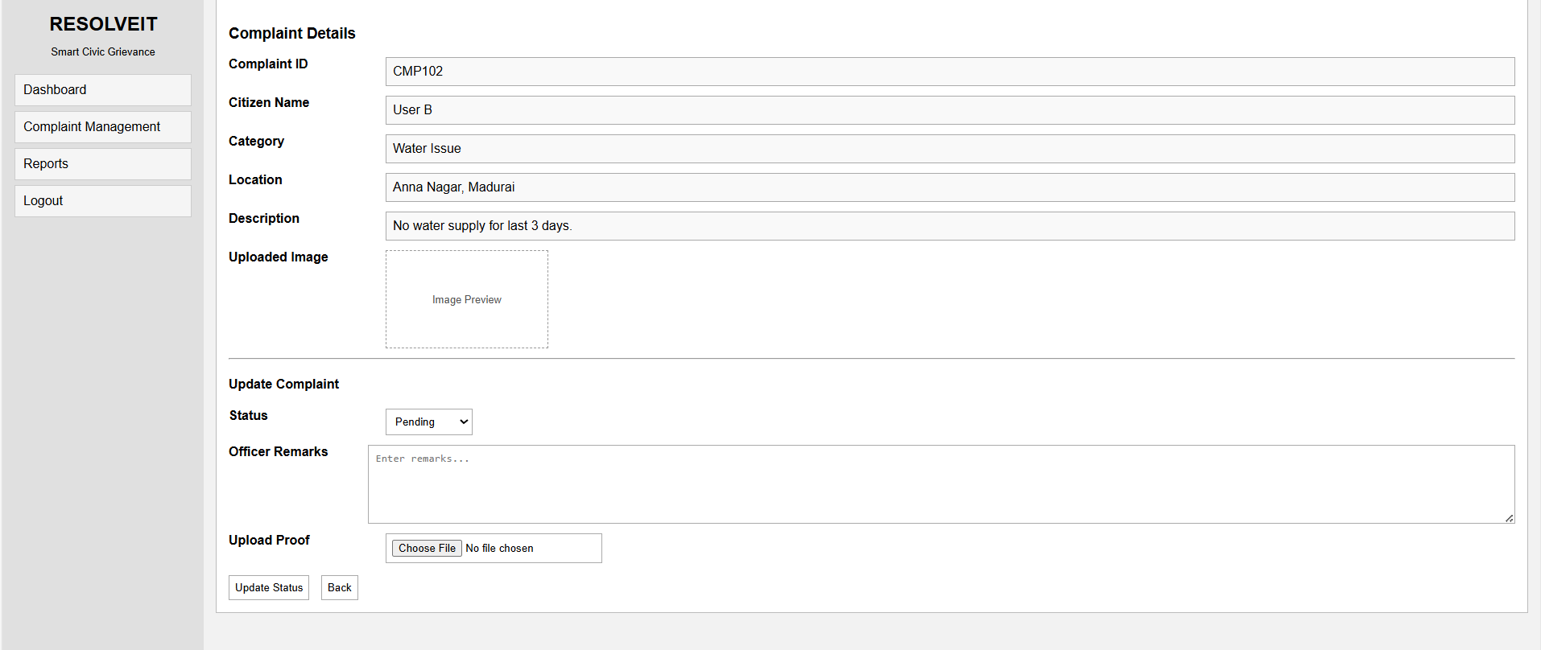
Officer Dashboard

Slide 21
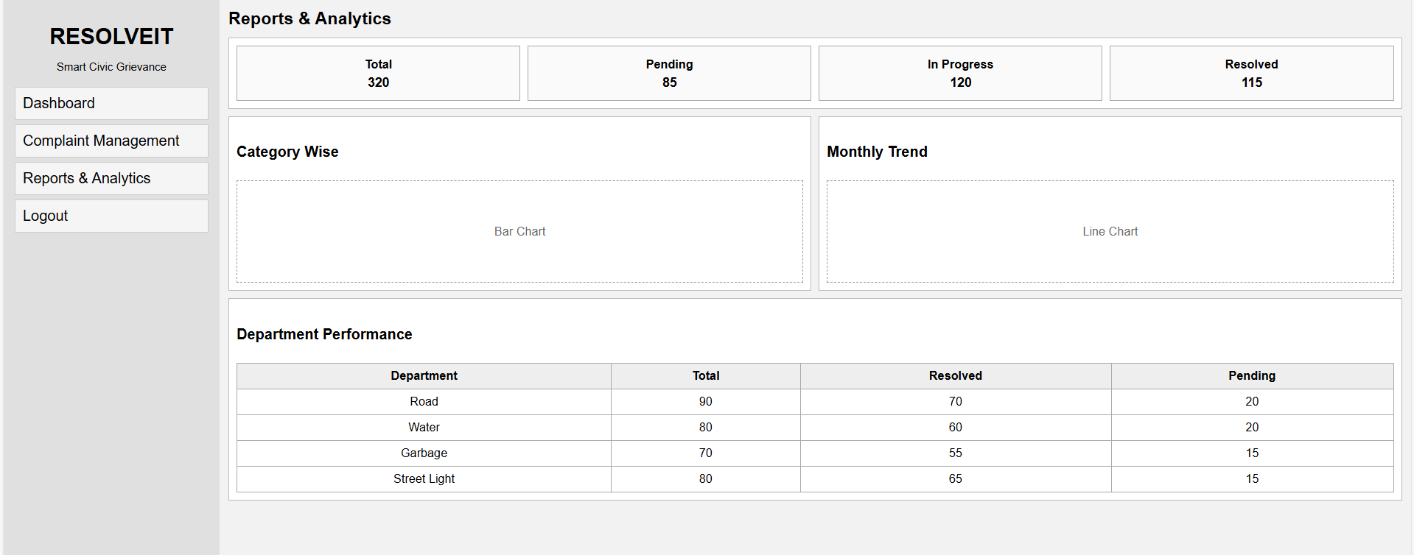
Reports and Analytics Page

Slide 22
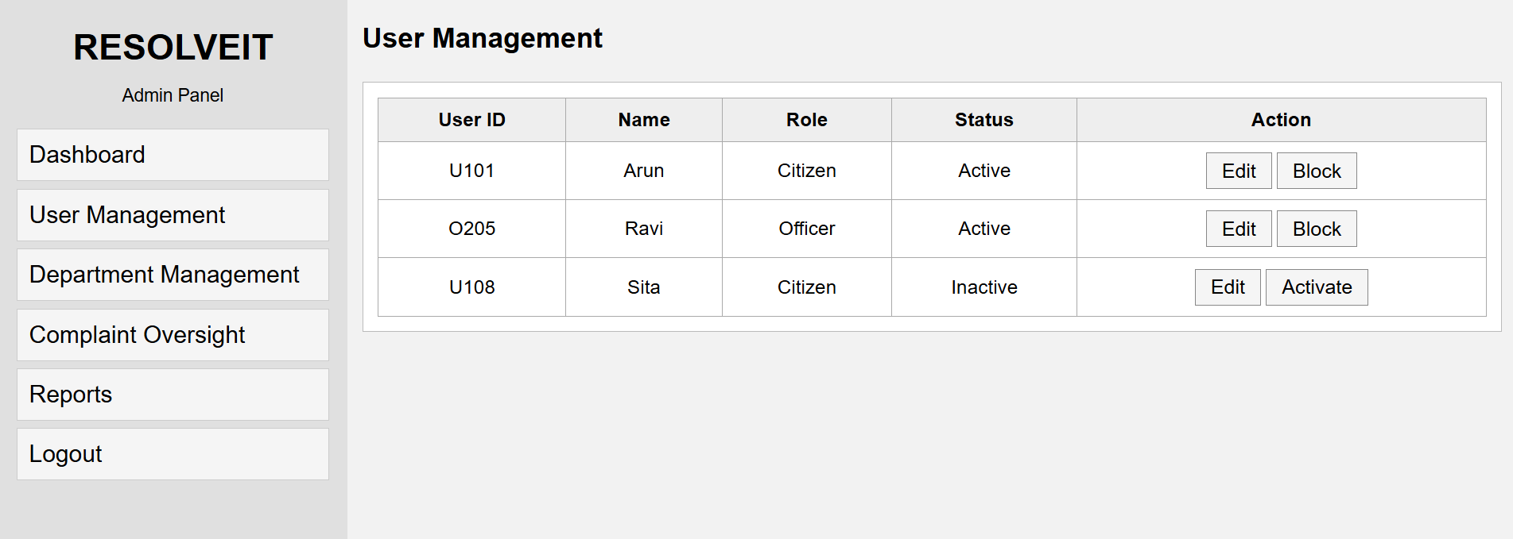
Admin Dashboard

Slide 23
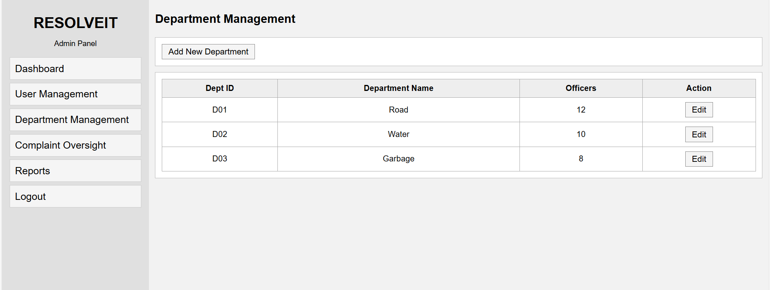

Slide 24
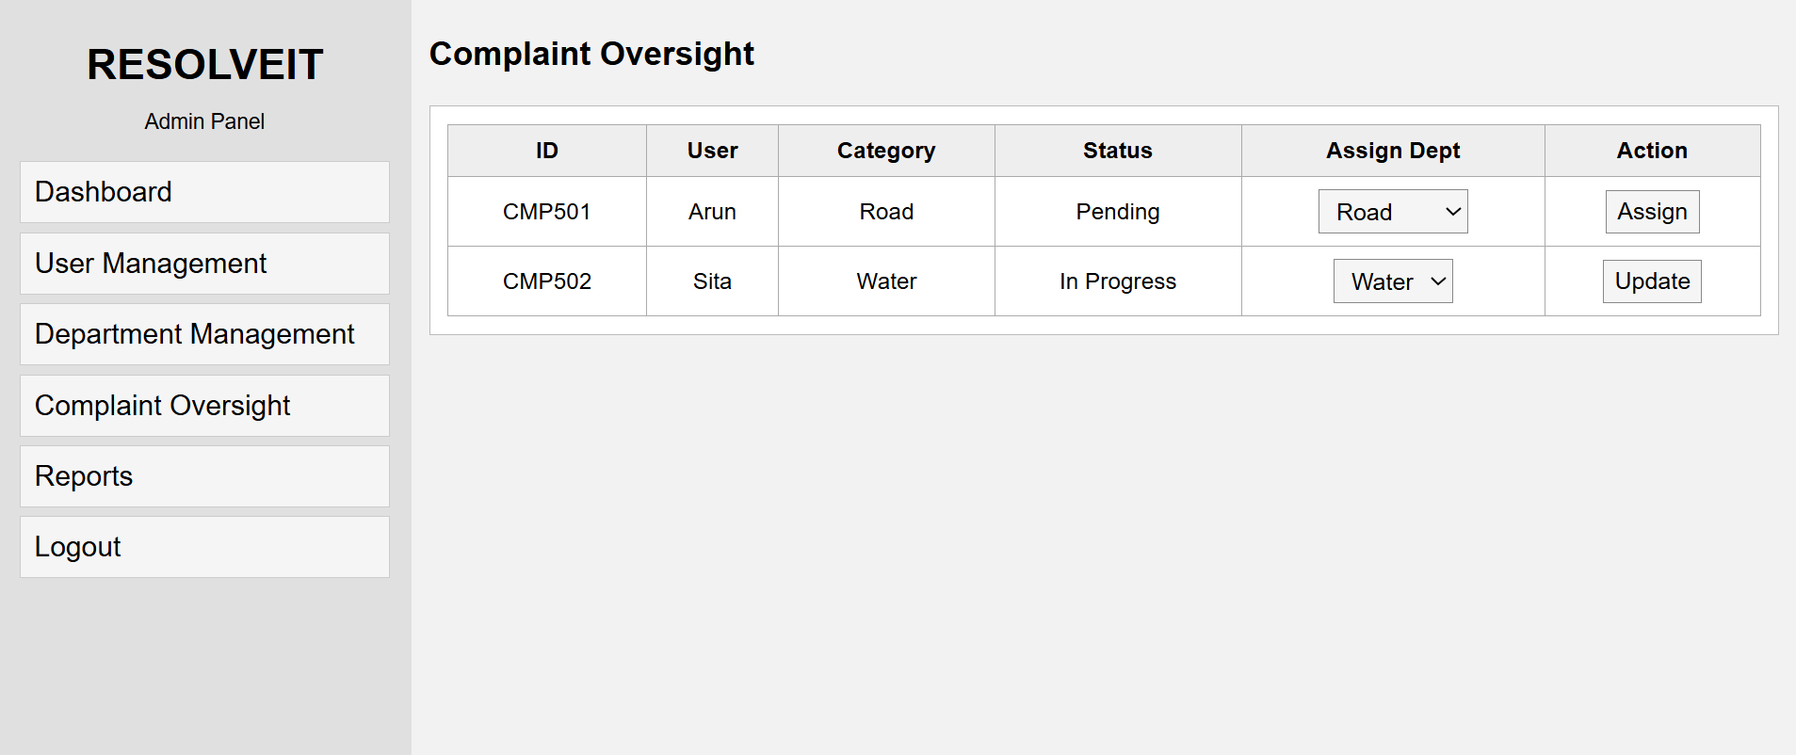

Slide 25
THANK YOU…

